Slide 1

Online Food Delivery Website
Task-3

Slide 2


Online Food Delivery Website
It is a online food delivery platform that connects hungry customers with a wide variety of restaurants and cuisines .
It is a user-friendly website ensuring seamless and satisfying experience for both users and restaurant partners.
LMS Username | Name | Batch
au910020104002 | ABINAYA P | CC2
au910020104004 | AKSHAYA S | CC2
au910020104015 | JAYAPRIYA S | CC2
au910020104038 | SANJAY N | CC2

Slide 3

Task 3 :
Evaluation Metric:
Performance Metrics:
Measure page load times and optimize for faster loading using tools like Lighthouse. Ensure a smooth user experience across different network conditions.
User Experience (UX):
Collect feedback on the overall design and usability through surveys or user testing. Evaluate the accessibility of the website for users with disabilities.
Error Handling:
Test and handle errors effectively. Track error rates and implement user-friendly error messages to guide users when issues arise.
Scalability:
Assess the performance of the application under various loads. Optimize code and resources to handle increased user traffic during peak times
User Engagement:
Monitor user engagement metrics, such as time spent on the platform and interaction rates. Analyze user behavior to improve features that enhance engagement
Browser Compatibility:
Test the application on different browsers to ensure compatibility. Resolve any issues that may arise on specific browsers.

Slide 4
Step-Wise Description
Performance Metrics: Optimize for fast loading using tools like Lighthouse.
User Experience (UX): Collect feedback on design and usability through surveys or user testing.
Error Handling: Track and address errors effectively with user-friendly messages.
Security: Conduct security audits and ensure secure data transmission.
Scalability: Optimize code for increased user traffic during peak times.
User Engagement: Monitor engagement metrics and analyze user behavior.
Conversion Rates: Track and optimize conversion rates for key actions.
Mobile Responsiveness: Ensure a seamless experience on various mobile devices.
Browser Compatibility: Test and resolve compatibility issues on different browsers.

Slide 5
Task Summary
The task involves developing a front-end codebase for an online food delivery project. Beginning with a uniform design, the HTML structure is crafted consistently, and CSS styling ensures a visually cohesive and polished appearance. Responsive design principles are implemented for cross-device compatibility. Transitioning to an interactive front end, JavaScript is integrated for features like dropdowns and sliders, providing a dynamic user experience. The codebase is evaluated using performance metrics, user experience feedback, and security audits. Scalability, user engagement, and mobile responsiveness are considered, ensuring a comprehensive and effective front-end solution for the online food delivery platform.

Slide 6
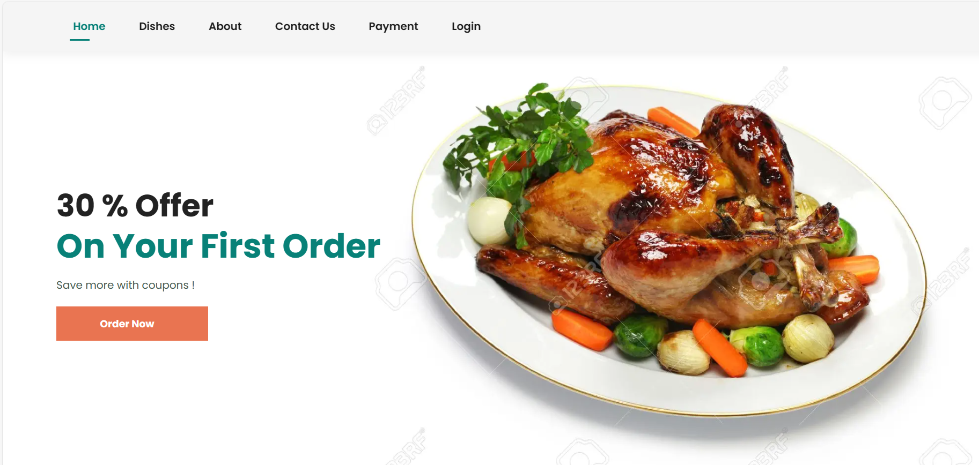
USER INTERFACE
HOME PAGE

Slide 7
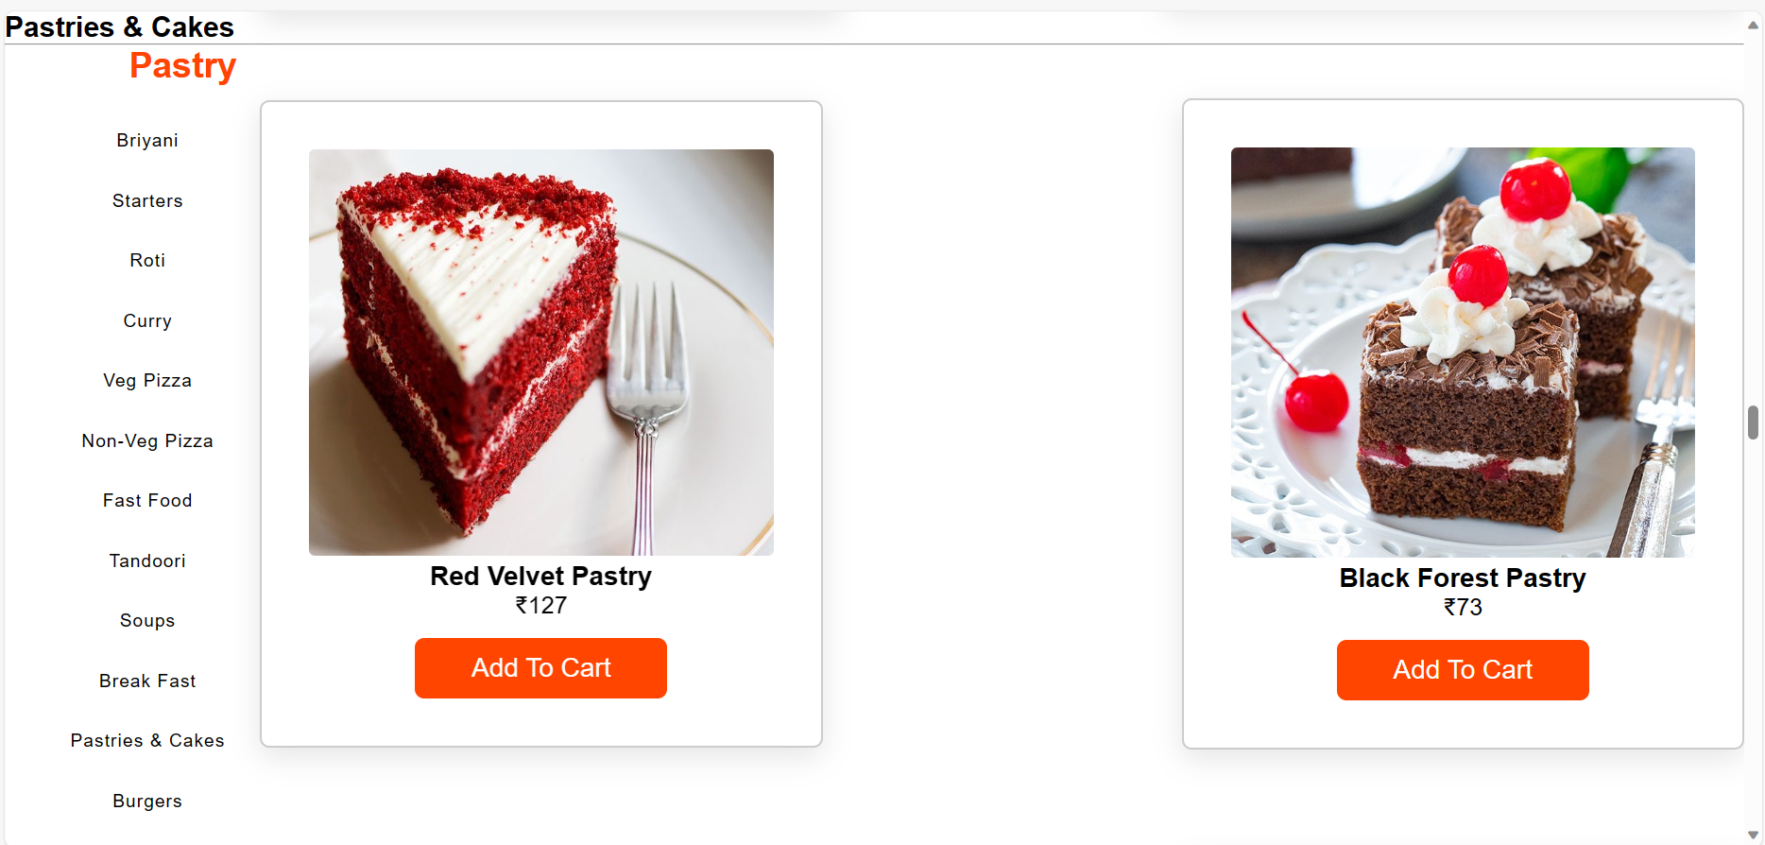
FOOD ORDERING PAGE

Slide 8
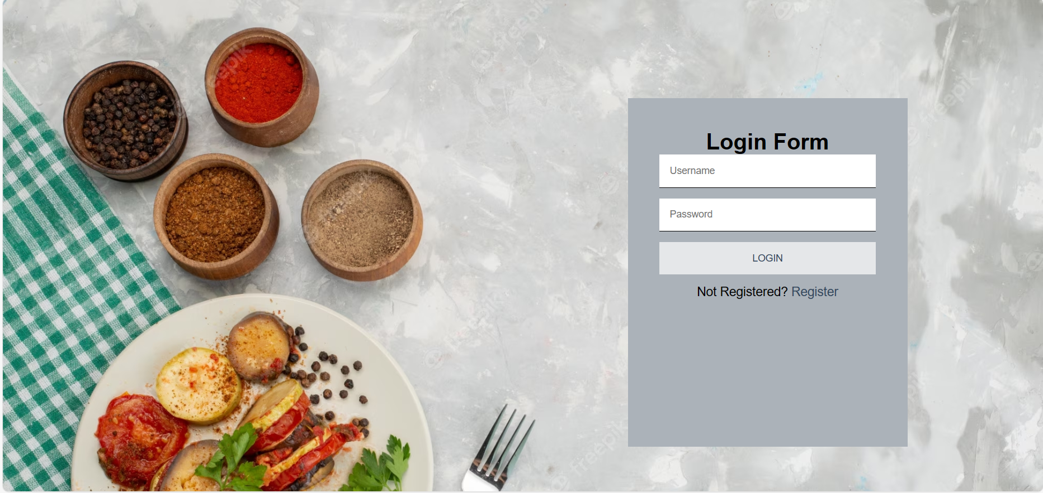
LOGIN / REGISTRATION PAGE

Slide 9
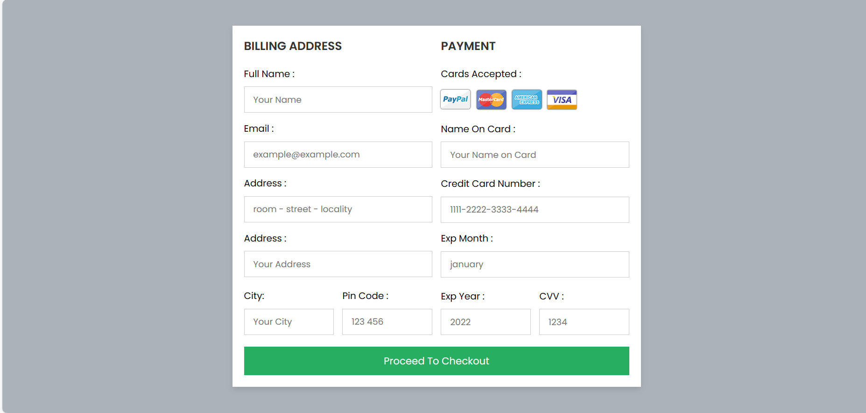
PAYMENT PAGE

Slide 10



Submission Github
https://github.com/13-akshaya/Online_Food_Delivery/tree/main

Slide 11


